Slide 1
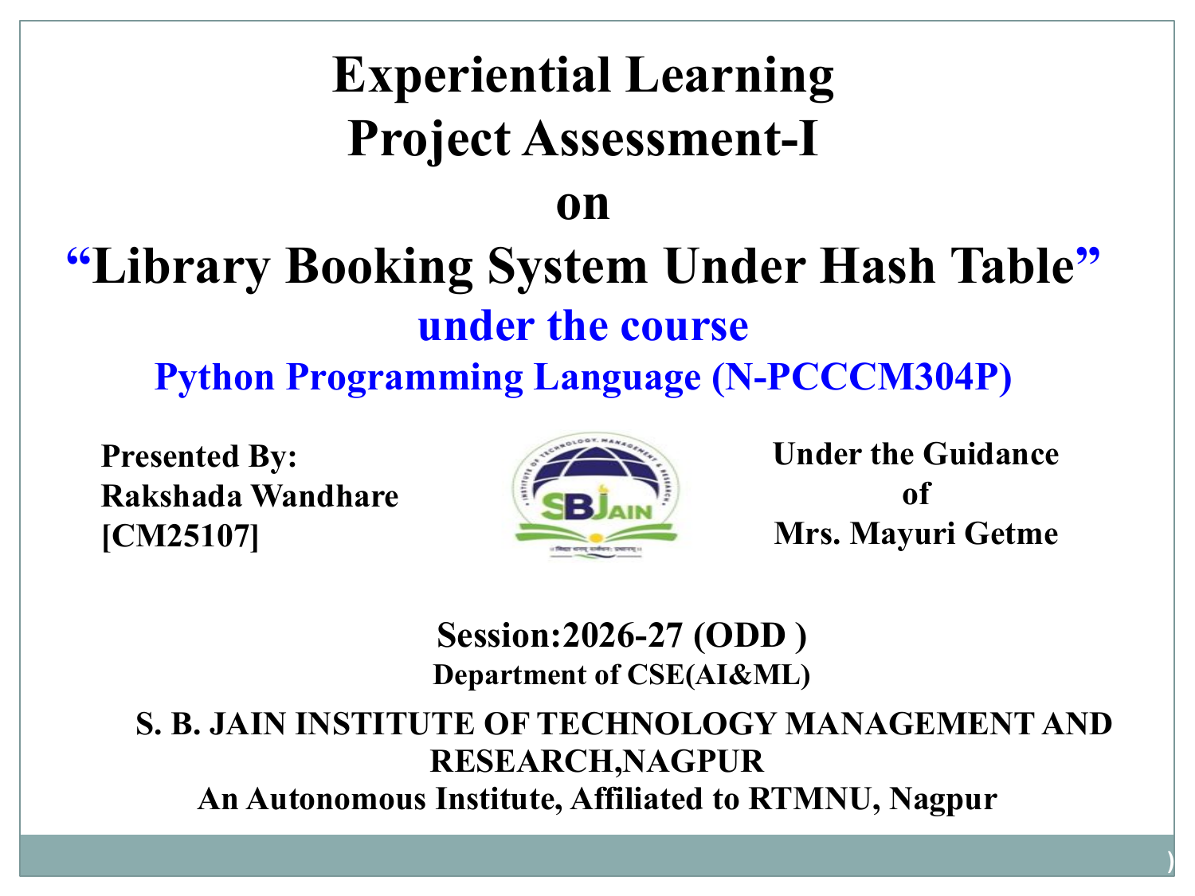

Experiential Learning
Project Assessment-I
on
“Calculator in Python”
under the course
Python Programming Language (N-PCCCM304P)
Presented By:
Aditi Jangde [CM25004]
Under the Guidance
of
Mrs Mayuri Ghetme
Session:2026-27 (ODD )
Department of CSE(AI&ML)
S. B. JAIN INSTITUTE OF TECHNOLOGY MANAGEMENT AND
RESEARCH,NAGPUR
An Autonomous Institute, Affiliated to RTMNU, Nagpur

Slide 2
Contents
• Problem Statement
• Objectives
• Algorithm
• Flowchart / Pseudocode
• Understanding of Python Logic
• Graphical Representation and Working
• GitHub Account, Repository & Collaboration
• Individual Contribution
• Result / Expected Output
S. B. Jain Institute of Technology Management and Research, Nagpur

Slide 3
1. Problem Statement
• Manual calculations can be slow and error-prone for repeated arithmetic operations.
• Users need a simple program to perform basic calculations quickly.
• The calculator should accept two numbers and an operation from the user.
• It should support addition, subtraction, multiplication and division.
• Invalid operators and division by zero must be handled safely.
• A modular Python solution should be easy to understand, test and extend.
• The project demonstrates how Python can solve a practical everyday problem.
S. B. Jain Institute of Technology Management and Research, Nagpur

Slide 4
2. Objective
To develop a simple calculator using Python for performing basic arithmetic operations.
To accept two numbers and an operator as input from the user.
To perform addition, subtraction, multiplication, and division accurately.
To handle invalid inputs and operators without causing the program to crash.
To prevent division-by-zero errors by validating the input before performing division.
To use Python functions and conditional statements to create a clear and organized program.
To demonstrate how Python can be used to solve a practical, everyday problem.
S. B. Jain Institute of Technology Management and Research, Nagpur

Slide 5
3. Algorithm
• Start the program.
• Display the available arithmetic operations.
• Read the first number, second number and user's choice.
• Call the calculator function with the entered values.
• Perform the selected operation using conditional logic.
• If division is selected, check whether the second number is zero.
• Display the calculated result or an appropriate error message.
• Stop the program.
S. B. Jain Institute of Technology Management and Research, Nagpur

Slide 6
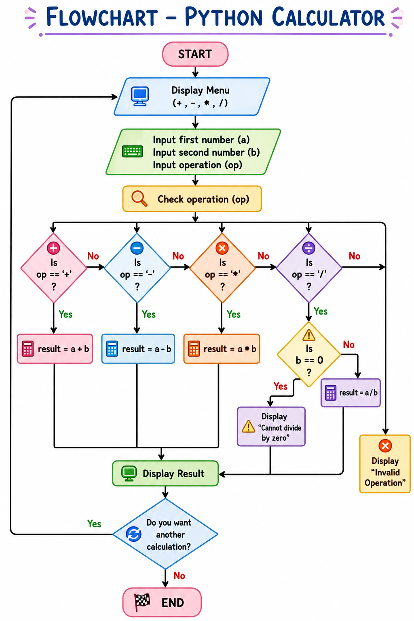
4. Flowchart
S. B. Jain Institute of Technology Management and Research, Nagpur

Slide 7
5. Understanding of Python Logic
def calculator(a, b, op):
if op == "+":
return a + b
elif op == "-":
return a - b
elif op == "*":
return a * b
elif op == "/":
if b == 0:
return "Cannot divide by zero"
return a / b
else:
return "Invalid operation"
a = float(input("Enter first number: "))
b = float(input("Enter second number: "))
op = input("Enter operation (+, -, *, /): ")
print("Result:", calculator(a, b, op))
S. B. Jain Institute of Technology Management and Research, Nagpur

Slide 8
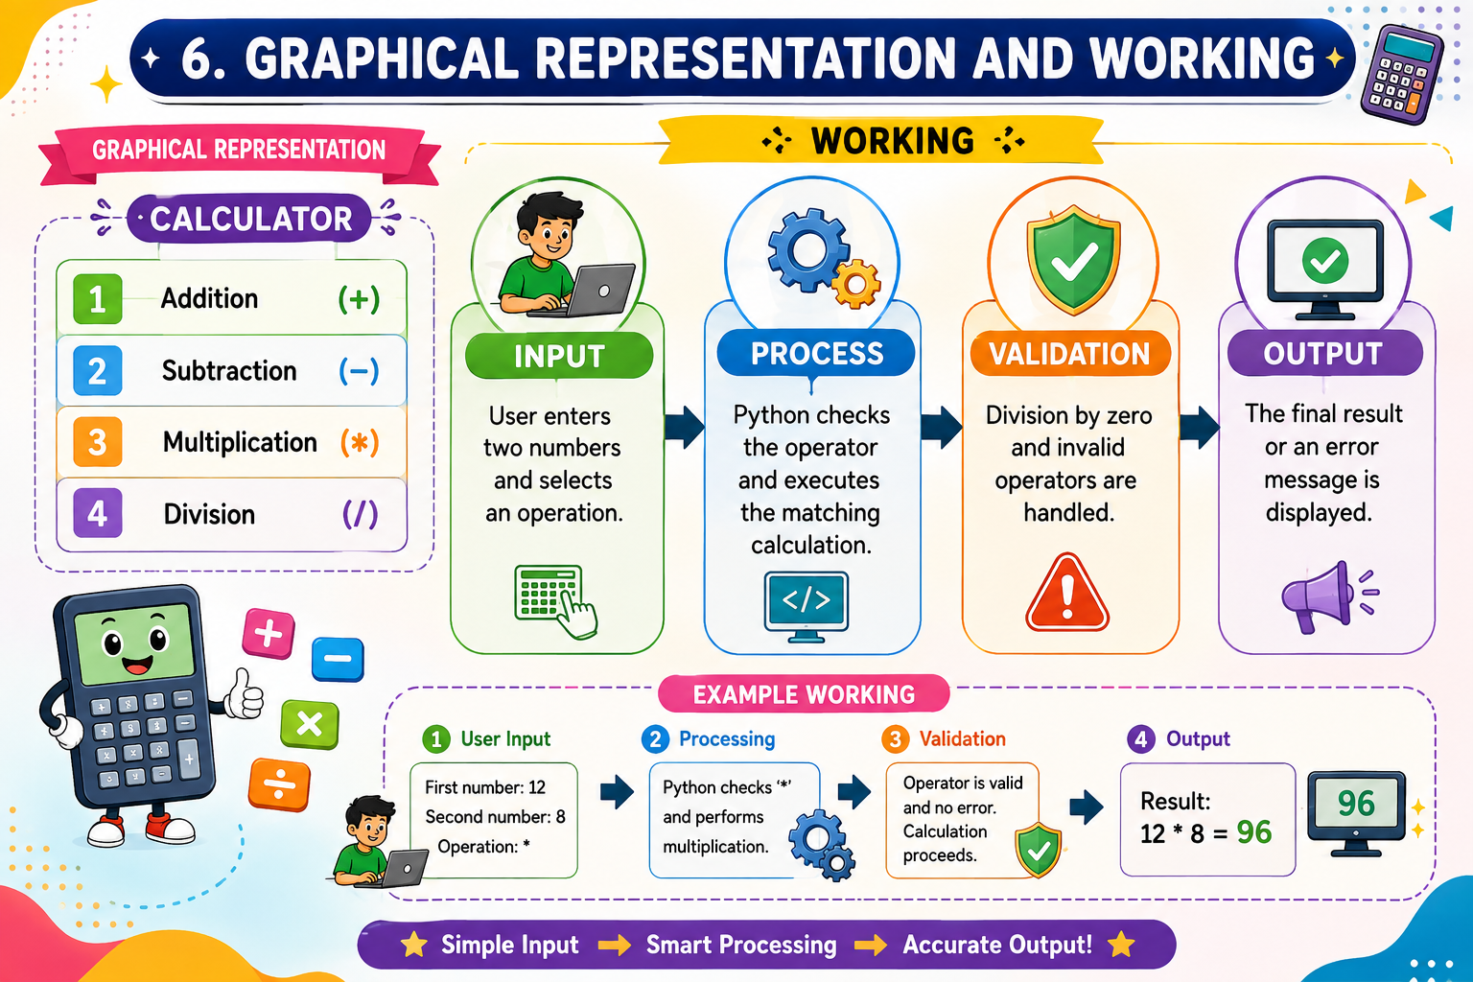
6. Graphical Representation and Working
S. B. Jain Institute of Technology Management and Research, Nagpur

Slide 9
7. GitHub Account, Repository & Collaboration
• Create GitHub Account – Set up a personal GitHub account.
• Create Repository – Create a repository for the calculator project.
• Upload Code – Upload the Python source file and documentation.
• Meaningful Commits – Save changes with clear commit messages.
• Collaboration – Share the repository and coordinate project work.
• Individual Contribution – Each member contributes through commits.
• Track Changes – Use GitHub history to manage and review updates.
S. B. Jain Institute of Technology Management and Research, Nagpur

Slide 10
8. Individual Contribution
• Problem Analysis – Identified the need for a simple and reliable calculator.
• Algorithm Design – Planned the input, operation-selection and output steps.
• Python Coding – Implemented calculator operations using a function.
• Testing – Tested addition, subtraction, multiplication, division and invalid cases.
• Documentation – Prepared the project explanation and presentation.
• GitHub Contribution – Uploaded the code and maintained meaningful commits.
S. B. Jain Institute of Technology Management and Research, Nagpur

Slide 11
9. Result / Expected Output
Python Calculator
Enter first number: 25
Enter second number: 5
Enter operation (+, -, *, /): /
Result: 5.0
The calculator performs the selected
operation and displays the result correctly.
S. B. Jain Institute of Technology Management and Research, Nagpur

Slide 12
Thank You
Calculator in Python
Python Programming Language • CM25004
S. B. Jain Institute of Technology Management and Research, Nagpur

